Slide 1
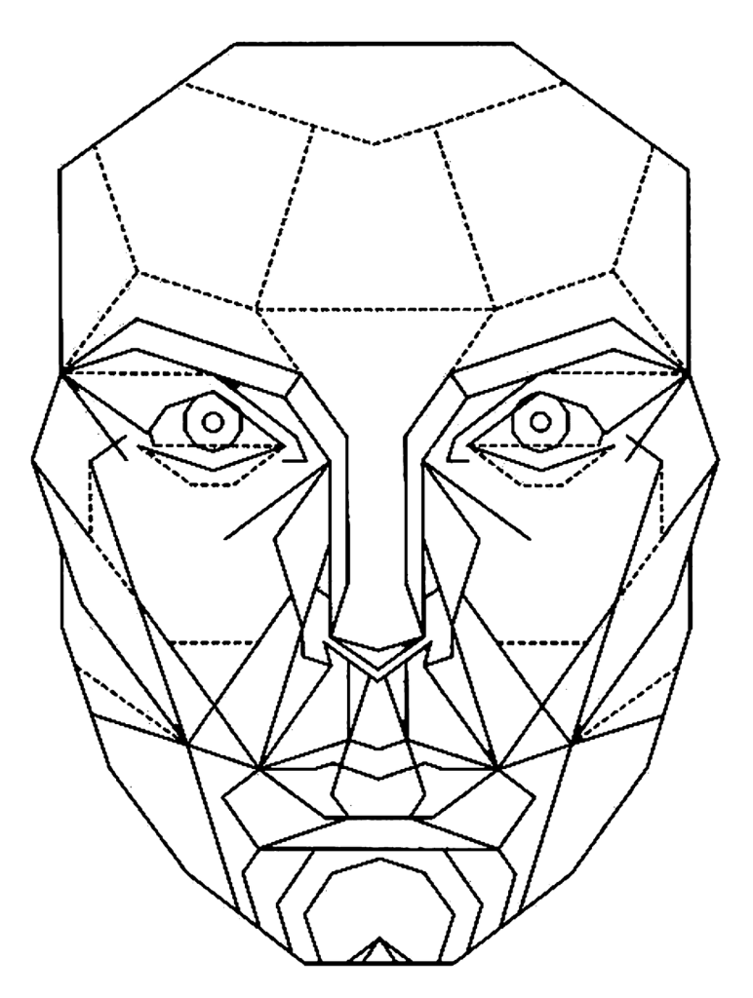
Facial Expression Recognition
Samuel Zeleke & Enoch Mwesigwa
CS 344

Slide 2
Vision
Build a facial-expression-recognition service hosted on a raspberry pi server.
The system should distinguish smile, sadness/frown, surprise/shock, disgust, fear, and neutral facial expressions
The system should be responsive enough to make predictions for frames from video streams

Slide 3
Background
There are two main types of object/facial detection models
R-CNN
YOLO – "You only look once"
Sharma deployed an architecture that resembles the R-CNN without its training performance limitations.
Uses opencv's trained cascade classifier to find faces
Uses transfer learning to use a weights and layers from VGG16 - a pre-trained keras' CNN
Achieves 85% accuracy

Slide 4
Implementation – Set-up
Facial-expression is divided into two steps
Step 1: Finding the face
Deployed on the client
Uses OpenCV's pre-trained facial recognition cascading classifier to find faces in frames/images
Returns a list of regions containing faces

Slide 5
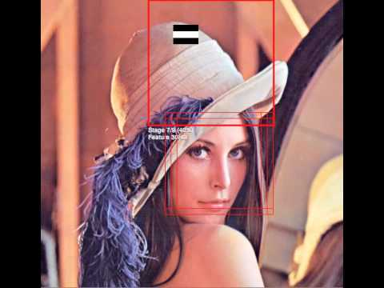
Implementation – Set-up
Facial-expression is divided into two steps
Step 1: Finding the face
Deployed on the client
Uses OpenCV's pre-trained facial recognition cascading classifier to find faces in frames/images
Returns a list of regions containing faces

Slide 6
Implementation – Set-up
Facial-expression is divided into two step
Step 2: Classifying the facial expression:
Deployed on the server (raspberry pi)
Uses a 5-layer CNN we trained on images scraped from Google search to classify facial expressions
Returns a string representing the facial expression

Slide 7
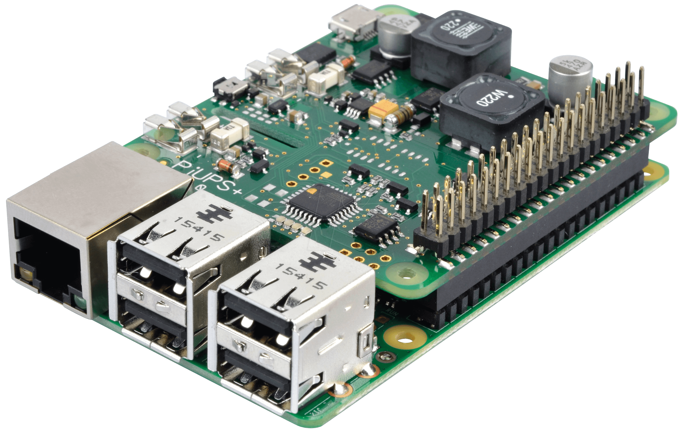
Implementation – Set-up
Server-Client communication done over MQTT messaging protocol
Emotion Str
Frame
Broker
Iot.cs.calvin.edu
Client(s)
Frame
Emotion str

Slide 8
Implementation – the Models
Model on the server (the raspberry pi)
Training dataset compiled from:
Zenodo - https://zenodo.org/record/3451524#.XssqtfJKiV4
Visgraf's FacesDB - http://app.visgraf.impa.br/database/faces/
Images scrapped from Google images
Model:
Input size – 256 * 256 RGB image
Output – 7-element long (one for each facial expression) array
The model's output translated to a string representing the facial expression. (e.g. "smiling", "sad", ...)

Slide 9
Results

Slide 10
Results
Our model's performance was limited by
Biases in the data
Inaccuracy of the cascading classifier

Slide 11
Implications
The technology could enable people who have difficulty recognizing emotions, like autistic people, the ability
The ability to divide object recognitions tasks between multiple devices entails significant performance improvements and enhance capabilities

